Slide 1



Slide 2
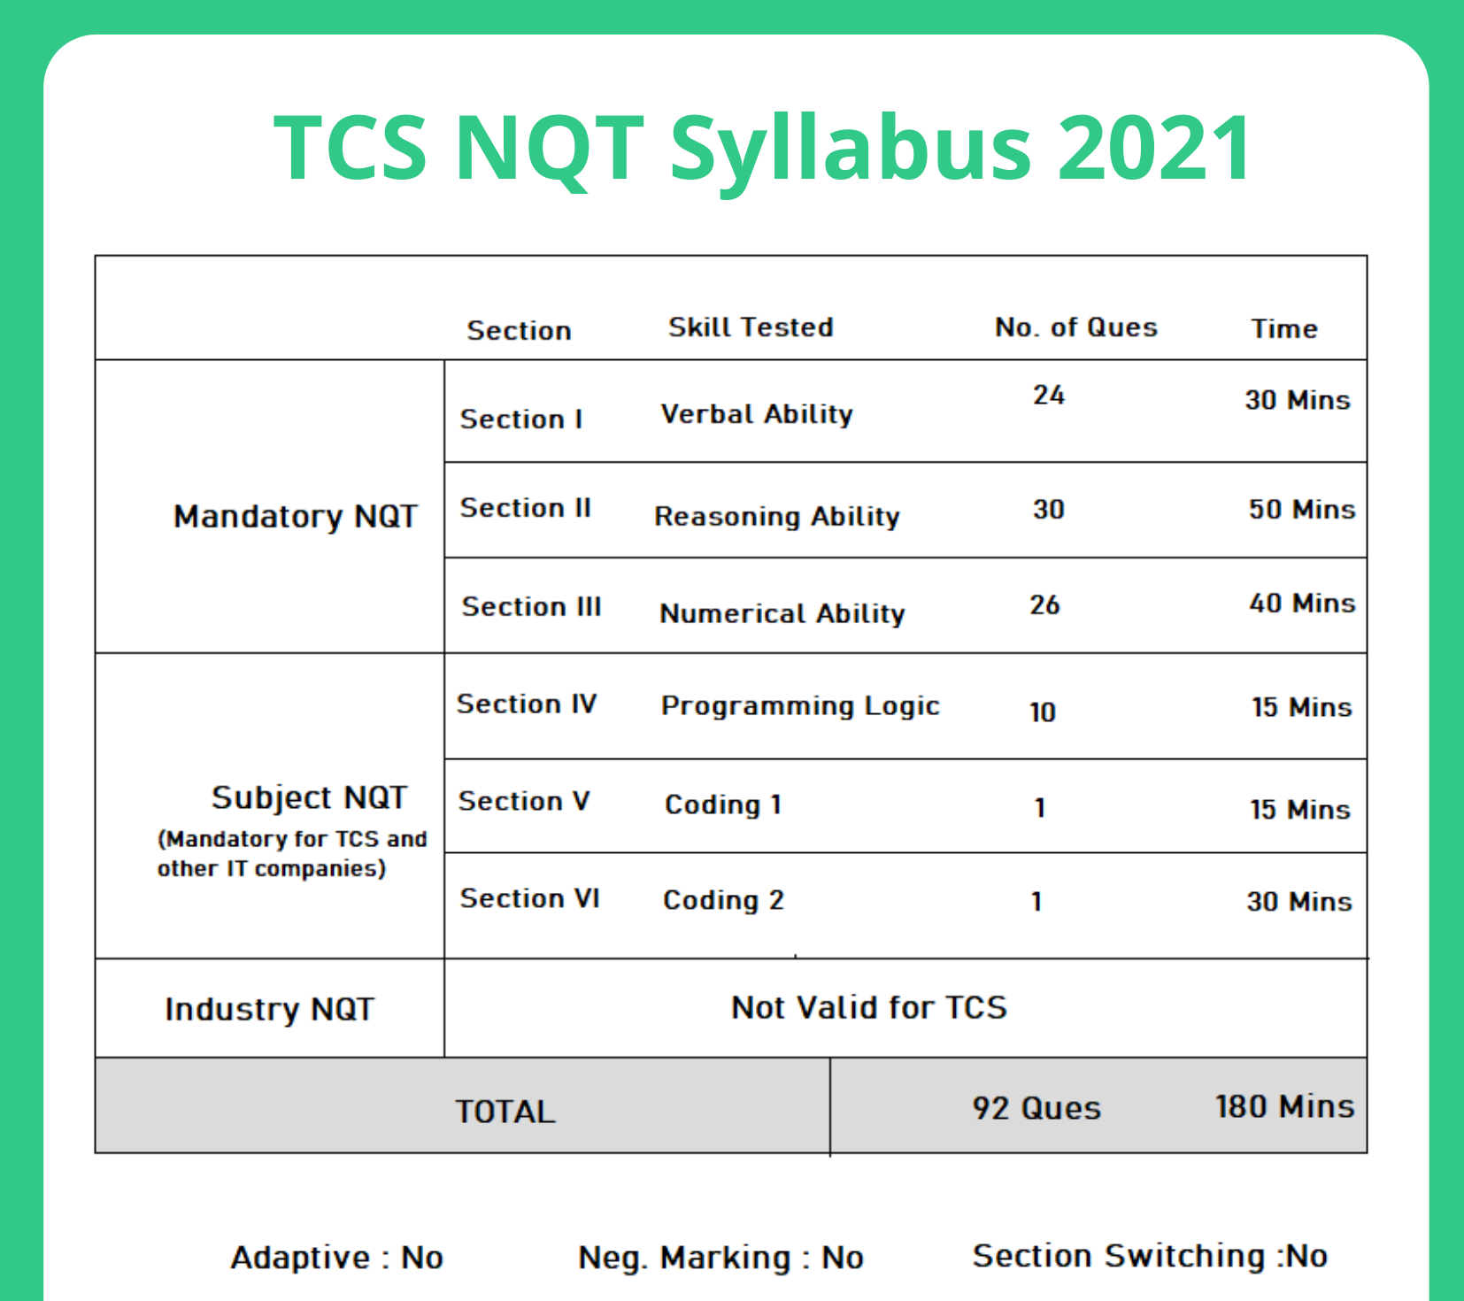

Slide 3
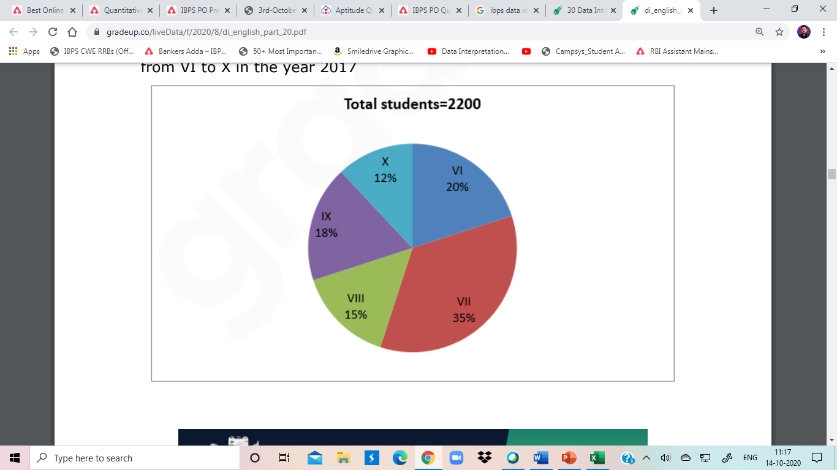
Direction (1-5 ): Study the pie chart carefully and answer the given questions. The pie chart shows the percentage breakup of students in different classes from VI to X in the year 2017
1. The total number of students study in class VI and class IX together is approximately what percentage more than that of the total number of students study in class X? A. 125% B. 280% C. 217% D. 189% E. 77%

Slide 4
2. If in class VI, the ratio of boys to girls is 6:5 and the total number of girls in class VI is 50 less than that of the total number of girls in class VII. Find the ratio of the total number of boys in class VI to class VII. A. 5:7 B. 7:11 C. 9:13 D. 6:13 E. 4:5

Slide 5
3. If in 2018, the total number of students in class VI and class VII is increased by 10% each and the total number of students in class VIII is decreased by 20% then what is the difference between the total number of students in class VI and VII together in 2018 to that of the total number of students in class VIII in 2018? A. 976 B. 1067 C. 1156 D. 1078 E. 878

Slide 6
4. If the total number of boys in class VIII is “x” and the total number of boys in class IX is “x+40”. The total number of girls in class VIII and class IX together is 306. Then find the value of “x”. A. 190 B. 210 C. 174 D. 184 E. 196

Slide 7
5. What is the difference between the total number of students in class VII and class VIII together to that of the total number of students in class IX and class X together? A. 480 B. 520 C. 440 D. 400 E. 560

Slide 8
Q6. Four circles having equal radii are drawn with centres at the four corners of a square. Each circle touches the other two adjacent circle. If remaining area of the square is 168 cm square, what is the size of the radius of the circle? (in centimeters ) (take π = 22/7)
(a) 1.4
(b) 14
(c) 35
(d) 21
(e) 3.5

Slide 9
Q.7 . A man wants to invest Rs. 16850 in bank account of his 2 sons, whose ages are 12 years & 16 years in such a way so that they will get equal amount at an age of 120 years at the rate of 33⅓% compounded annually. Find the share of younger son? (a) 4050 (b) 4080 (c) 4090 (d) 4085

Slide 10
Q.8
.A bag contains 5 red and 7 white balls. Four balls are drawn out one by one and not replaced. What is the probability that they are alternatively of different colours? a) 7/99 b) 11/99 c) 14/99 d) 19/99 e) None of these

Slide 11
Q.9 The ratio of the age of Ram and Rahim 10 years ago was 1 : 3. The ratio of their age five years hence will be 2 : 3. Then the ratio of their present age is
A) 1 : 2
B) 3 : 5
C) 3 : 4
D) 2 : 5

Slide 12
Q.10
Amit opened a workshop by investing Rs.60000. He invested additional amount of Rs.8000 at the end of every year. After 2 years Hemant joined him with an amount of Rs.80000. Thereafter Hemant did not invest any additional amount. Find the difference between their shares in profit, if total profit at the end of 4 years is Rs.35000.
(A)Rs.10000
(B)Rs.12500
(C)Rs.85000
(D)Rs.75000
(E)Rs.90000

Slide 13
Q.11
If 2 men or 3 women or 4 boys can do a piece of work in 52 days, then the same piece of work will be done by 1 man, 1 woman and 1 boy in : a) 48 days b) 36 days c) 45 days d) Data inadequate e) None of these

Slide 14
Q12
.A ship 55 km from the shore springs a leak which admits 2 tonnes of water in 6 minutes, 80 tonnes would suffice to sink her, but the pumps can throw out 12 tonnes an hour. The average rate of sailing that she may just reach the shore as she begins to sink is:
(a) 9.17 km/h (b) 0.97 km/h
(c) 55 km/ (d) 5.5 km/h
(e) None of these

Slide 15
Q.13
In a college election between two students, 10% of the votes cast are invalid. The winner gets 70% of the valid votes and defeats the loser by 1800 votes. How many votes were totally cast?1) 1800 2) 7200 3) 5000 4) 3600 5) None of these

Slide 16
.Q.14
Praveen travelled from city A to city B at the speed of 60 kmph and back from city B to city A, via the same route at the speed of 40 kmph. Find his average speed for the round trip?
1) 48 kmph 2) 50 kmph 3) 36 kmph 4) 40 kmph 5) None of these

Slide 17
Q.15
Train – A crosses a stationary train – B in 50 seconds and a pole in 20 seconds with the same speed. The length of the train – A is 240 metres. What is the length of the stationary Train-B? (a) 360 metres (b) 260 metres (c) 300 metres (d) 350 metres (e) 320 metres

Slide 18
Q.16
2 Men & 3women completed a task in 12days.if the women are at least half as efficient as the men,but not more efficient thsn the men,what is the range of the number of days for 3women & 1 man to complete the same task?
A.16 to 17.5 b.16.8 to 17.5 c.15 to 17.5 d.15 to 16.8 days

Slide 19
Q.17
“A” can complete a piece of work in 8 days ,while “B” is 20% more efficient than him.A works for 2 days ,then B works for 1 day,and the cycle continues like this.in how many days would the work be completed? a.7(3/5) b.7 days c.7(7/9) d.not

Slide 20
Q.18
.There are three taps A,B,C .A takes 4 times the time taken by B & C together to fill the tank .C takes 5 times the time taken by A & B together to fill the tank . In how much time can A fill the tank alone ,if the three taps together require 1hr 12min to fill the tank?
a.6 hrs b.5hrs c.7hrs d.not

Slide 21
Q.19
Two dice are thrown simultaneously. What is the probability of getting two numbers whose product is even?
1/2 2/3 3/4 Not

Slide 22
Q20
. A man swimming in a stream which flows 2.5 kmph finds that in a given time he can swim thrice as far with the steam as he can against it. How much distance he will cover in 4 hours against the current? (a)10 km (b)14 km (c)8 km (d)9 km (e)12 km

Slide 23
Q21.
The simple interest (p.a.) accrued on an amount of Rs 17,000 at the end of four years is Rs 6,800. What would be the compound interest (compounded annually) accrued on the same amount at the same rate in two years? (a) Cannot be determined (b) Other than those given as option (c) Rs 3570 (d) Rs 3260 (e) Rs 3980

Slide 24
Q.22
1.I. 4x2 + 3x – 27 = 0,
II. 3y2 – 20y + 32 = 0
A) If x > y
B) If x < y
C) If x ≥ y
D) If x ≤ y
E) If x = y or relation cannot be established

Slide 25
Q.23. X and Y Both sell the same product .The marked price of the product is Rs.28000.X gives a discount of 10% on whole , while gives the discount of 12% on the first 20000 & 8 %on the rest of rs8000.what is the difference between their selling price ?
a)240 b)24000 c)160 d)150 e)125

Slide 26
(Q.24) Find the missing number in the given seriese.
(1).2, 7, 10, 22, 18, 37, 26,?
A. 42
B. 52
C. 46
D. 62
E.None of these

Slide 27
Q25. 12, 12, 18, 45, 180, 1170, ?
(a) 12285
(b) 10530
(c) 11700
(d) 12870
(e) 9945

Slide 28
Q26 Find the wrong tern in the series
2 , 3 , 10, 38, 172
(a) 2
(b) 3
(c) 10
(d) 38
(e)172

Slide 29
Q. A number is chosen from first 100 natural numbers. Find the probability that the number is divisible by both 2 and 3. (a) 4/25 (b) 6/25 (c) 8/25 (d) 16/25 (e) 9/25

Slide 30
A woman goes to visit the house of some friend whom she has not seen for many years. She knew that besides the two married adults in the household, there are two children of different ages, But she does not know their genders. When she knocks on the door of the house, a boy answer. What is the probability that the younger child is a boy? (a) 2/3 (b) 1/2 (c) 1/3 (d) 1/4

